Slide 1

xv6原码分析 第三部分
白埔瑞 潘鹏程 王意晨

Slide 2

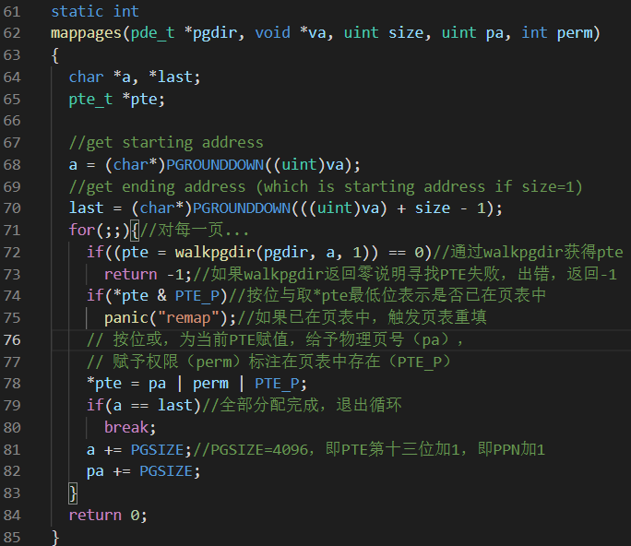
Which commands can be supported or will be supported by your shell?
函数分析
mappages()函数

Slide 3
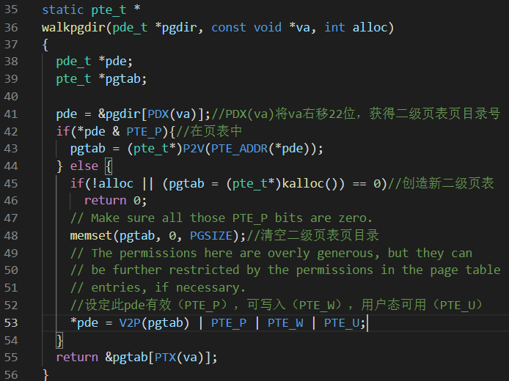
Which commands can be supported or will be supported by your shell?
函数分析
walkpgdir()函数

Slide 4
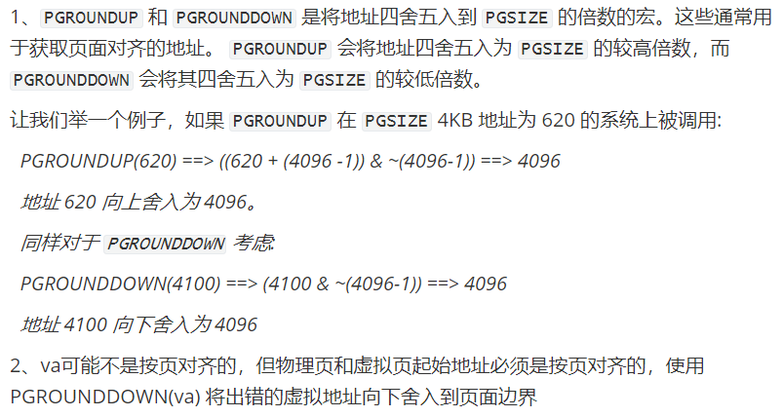
Which commands can be supported or will be supported by your shell?
Q1：
mappages()函数中PGROUNDDOWN()函数的作用是什什么？为何需要调用该函数？

Slide 5
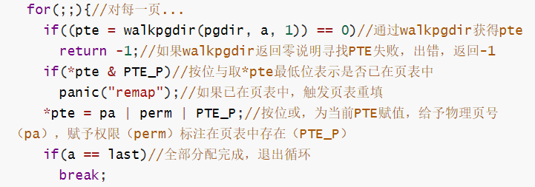
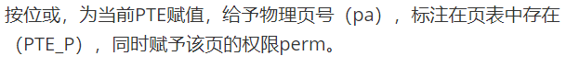
Q2：
mappages()函数中“*pte = pa | perm | PTE_P;”代码的含义是什么？

Slide 6
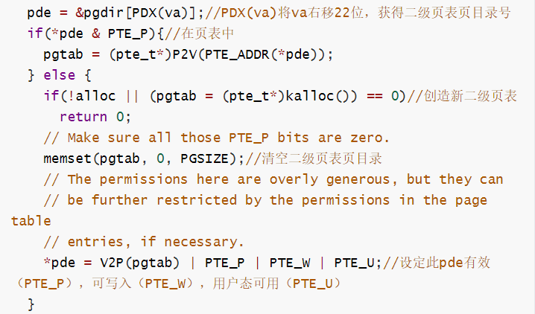
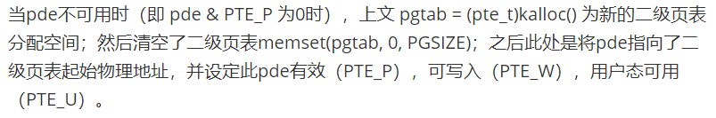
Q3：
walkpgdir()函数中“*pde = V2P(pgtab)
| PTE_P | PTE_W | PTE_U;”代码的含义是什么？

Slide 7
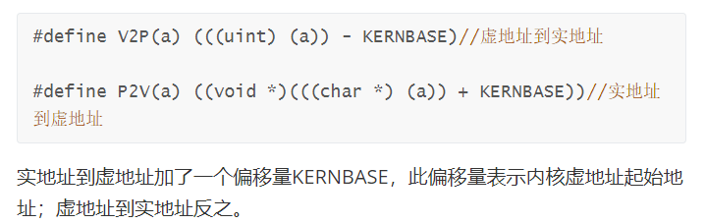
How do you handle semaphores, and barrier? What to do if timer interrupt occurs?
Q4：
virtual address与physical address的映射关系是什什么？对虚拟内存是如何实现的？(page swap)

Slide 8
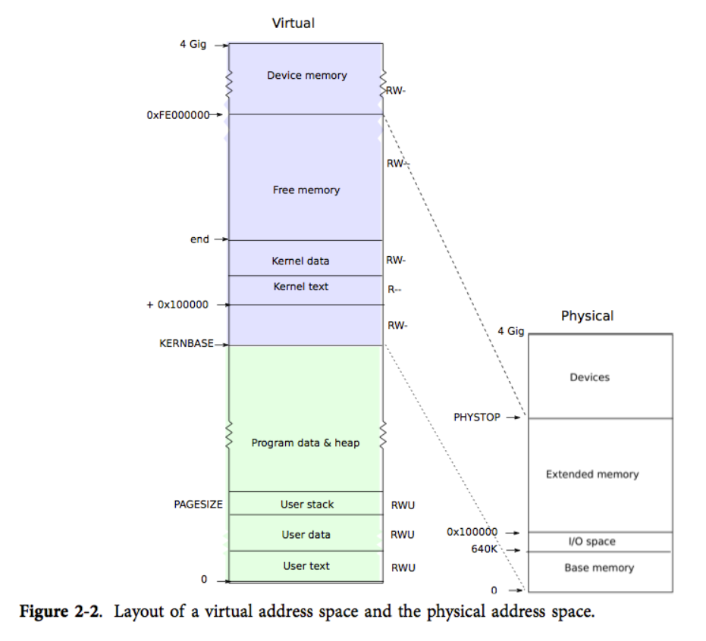
How do you handle semaphores, and barrier? What to do if timer interrupt occurs?
Q4：
virtual address与physical address的映射关系是什什么？

Slide 9
How do you handle semaphores, and barrier? What to do if timer interrupt occurs?
Q5：
进阶：linux代码中virtual address与physical address是如何映射的？如何实现了了虚拟内存(page swap)？请结合相关源码[mm/vmscan.c]进行分析。

Slide 10
THANKS
谢谢

